Slide 1
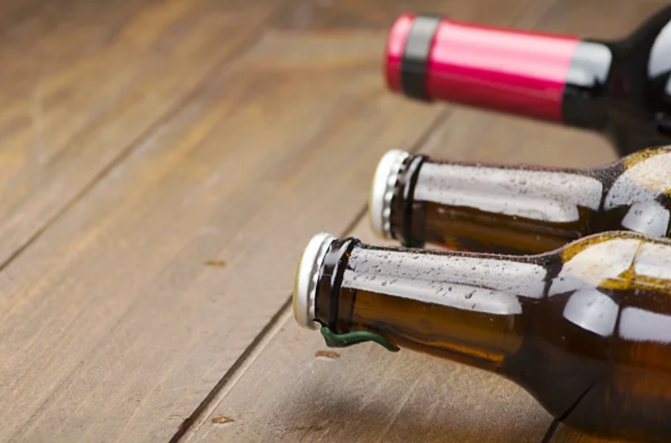
How Much Beer Do I Need to Stock? An Automated Approach to Demand Forecasting
Jenna Ford, Christian Nava & Jonathan Tan
Advisor: Dr. Bivin Sadler

Slide 2
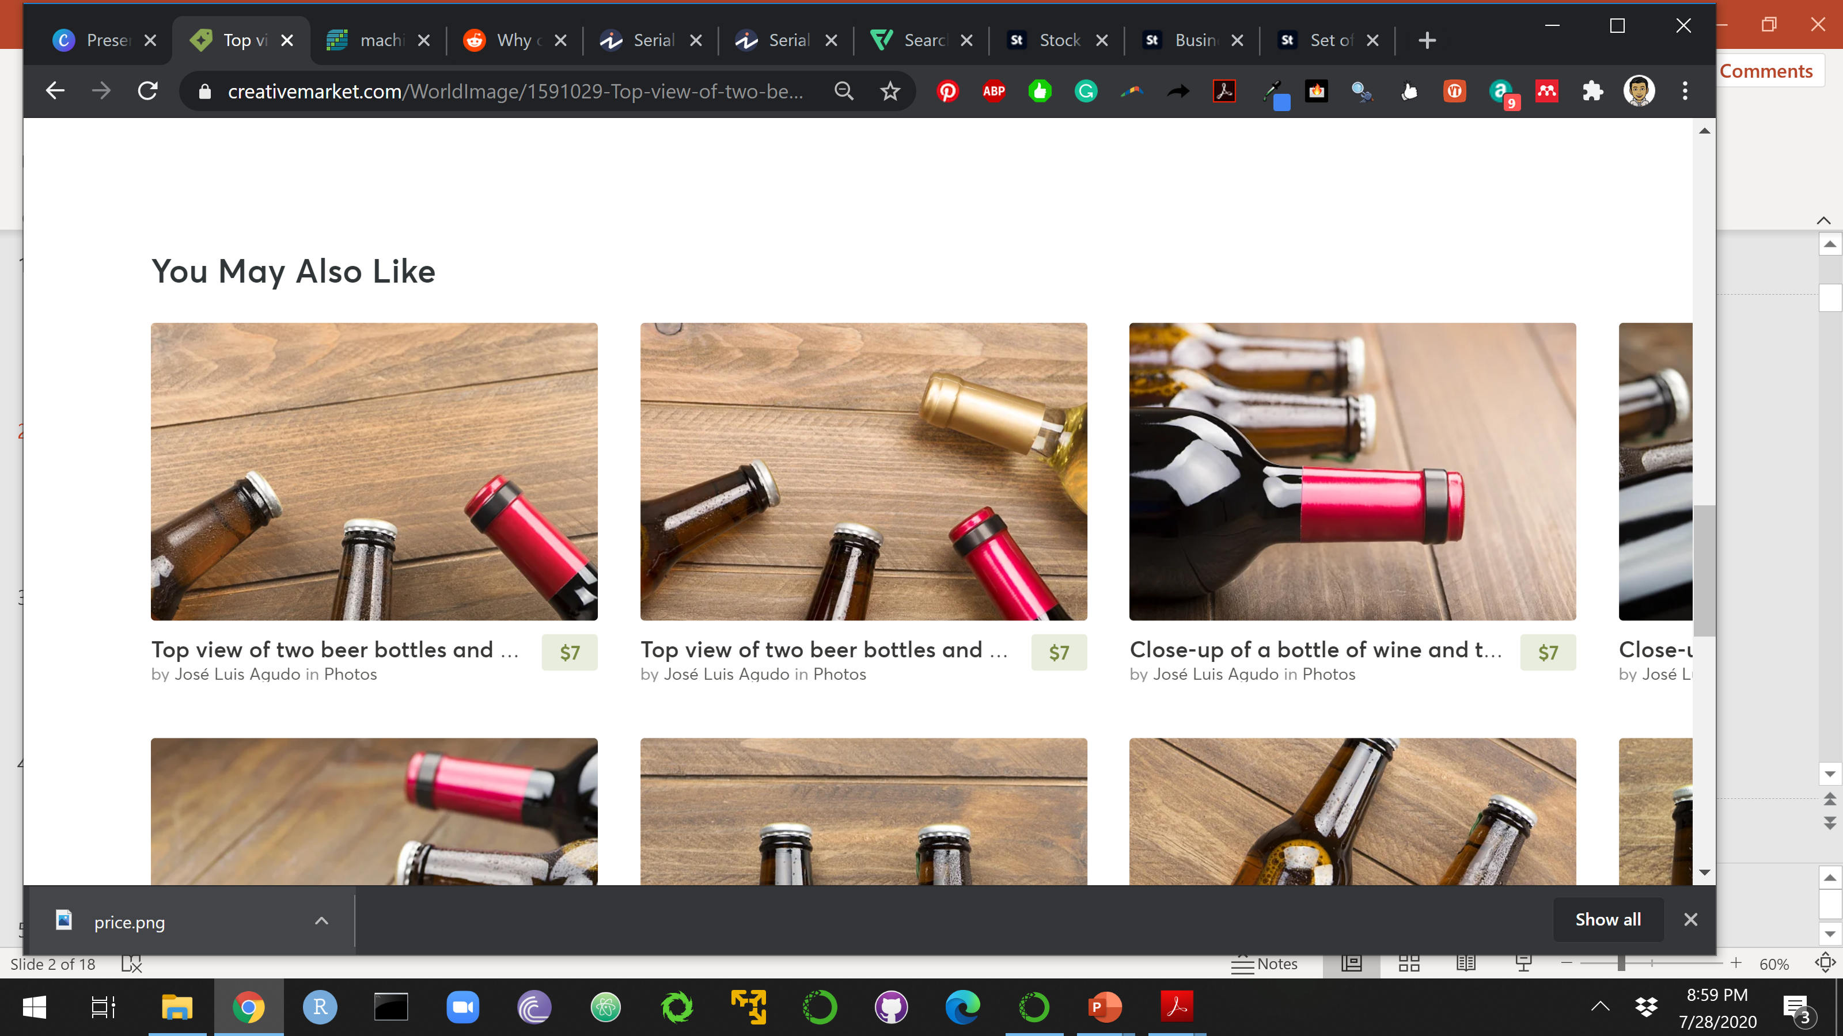
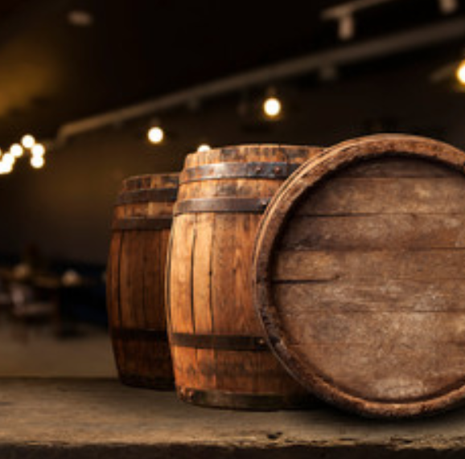
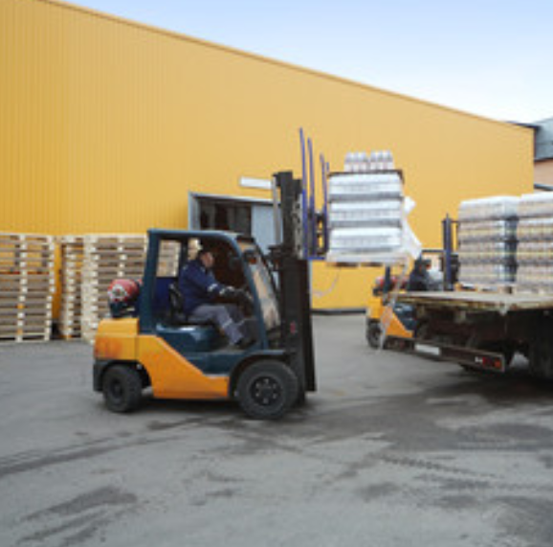
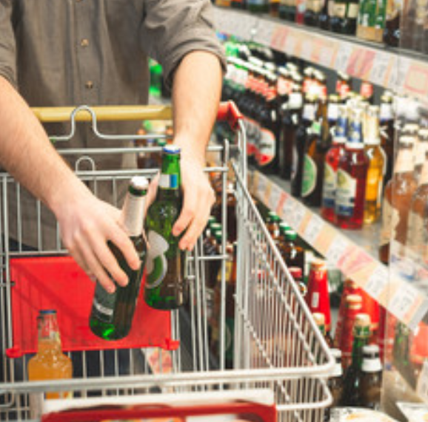
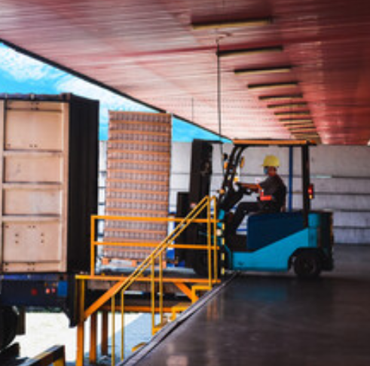
The three-tiered system
Manufacturer/
Importer
Wholesale
Distributor
Retailer
Notes:
Too much stock will go bad: distributor will have to throw it out or send it back. Cost associated with inventory.
Too little stock then you sell out and leave revenue on the table. If you can order more, costs will increase.

Slide 3
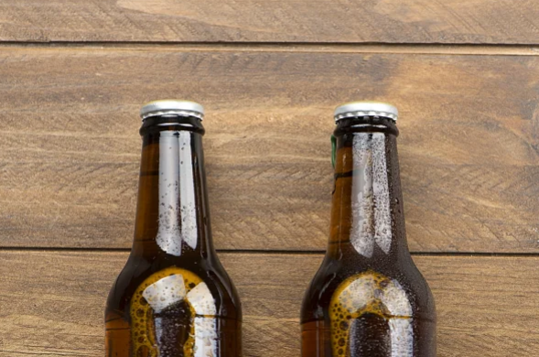
1
National wholesale alcohol distributor
Dataset
HIGH-LEVEL OVERVIEW
1
Metropolitan area
4,017
Products
34
Customers
37,391
Product/customer combinations

Slide 4




Single Analyst
Thousands of product combinations
Decrease in time and costs
Does not require an increase in headcount
Notes:
One person could analyze every combination, but this is very time consuming and expensive to do.
Would require a team of people.

Slide 5

AutoML
Thousands of product combinations
Decrease in time and costs
Does not require an increase in headcount
Notes:
Forecast sales at a store/customer level to know how much product the distributor should carry in inventory.
Automated approach that will quickly identify the best model with little human intervention.

Slide 6
What AutoML has mostly been used for
More widespread for non time-series applications
Lit review stuff
(30 seconds)

Slide 7
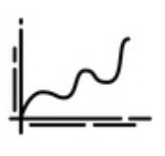

Why can’t I just do a regression?
Serially correlated data
Expensive mistake
Bad forecasts
Notes:
Will result in biased estimates of the variance, or, in other words, the errors for this time period will carry over into future time periods. In our case, an overestimate of stock this period would not be corrected in the following time period, which will turn out to be a very expensive mistake.

Slide 8
AutoML Framework
INPUT
Univariate Time Series
Record Data Characteristics
Fit Multiple Models
Make Predictions
RESULTS
Model & Predictions
Return Metrics

Slide 9
Stationarity
Constant mean
Constant variance
Constant autocorrelations
Important because it’s an assumption for some models
Transformations on the data can correct for this
One reason why time-series analysis is different

Slide 10


White Noise
SIGNAL
NOISE
TIME
SERIES
What we can model & predict
What we cannot predict
Notes:
If we can perfectly capture all the components that make up the signal, then the resulting residuals, or errors, would be white noise, or something we cannot predict. So, if we can prove that the model residuals are white noise, then that means the model is probably a good one and did a good job at .

Slide 11
Models
Traditional time series models
Deep learning models
List of models with graphics

Slide 12
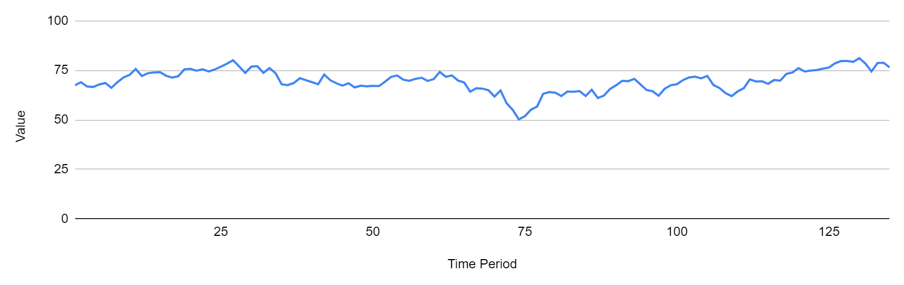
Rolling-window ASE
window
horizon
Training Set
Forecast
Dropped
Window 1
Window 2
Window 3
Window 4
Window 5
Window 6
…
…
Window n

Slide 13
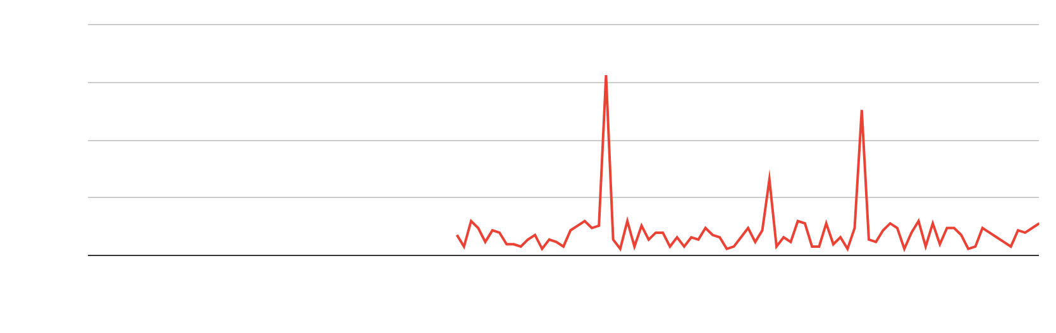
Rolling-window ASE
4
3
2
ASE
1
0

Slide 14
Results: Not White Noise
White Noise Results | Model | Rolling-Window ASE
 |  | 3-Month Forecast | 12-Month Forecast
Not white noise | Equal Means | 7.49 | 9.07
 | ARMA | 6.44 | 6.87
 | ARIMA, d=1 | 9.90 | 9.31
 | ARIMA, s=12 | 8.66 | 9.98

Slide 15
Results: White Noise
White Noise Results | Model | Rolling-Window ASE
 |  | 3-Month Forecast | 12-Month Forecast
White noise | Equal Means | 0.74 | 0.57
 | ARMA | 0.88 | 0.75
 | ARIMA, d=1 | 0.86 | 0.72
 | ARIMA, s=12 | 1.47 | 2.18

Slide 16
Aggregation
Placeholder
(2 slides)

Slide 17
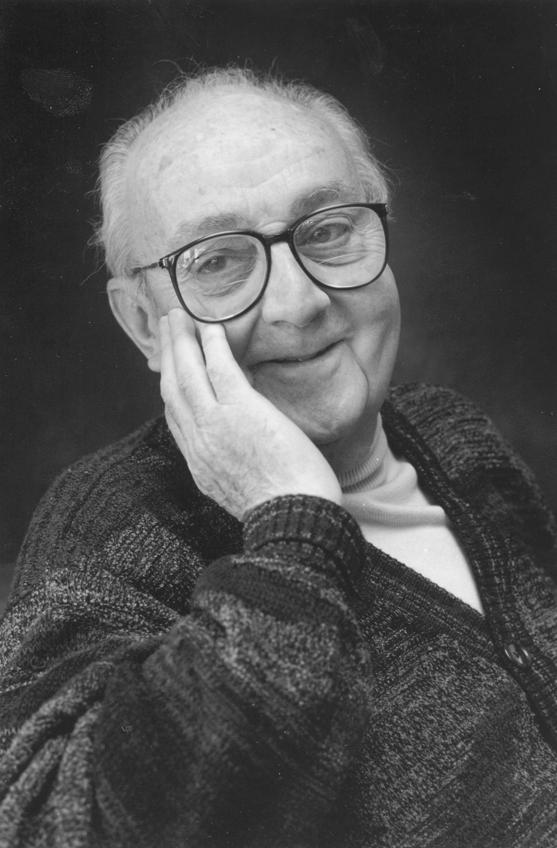
“
All models are wrong, but some are useful.
- George Box

Slide 18
summary
2 slides

